Slide 1

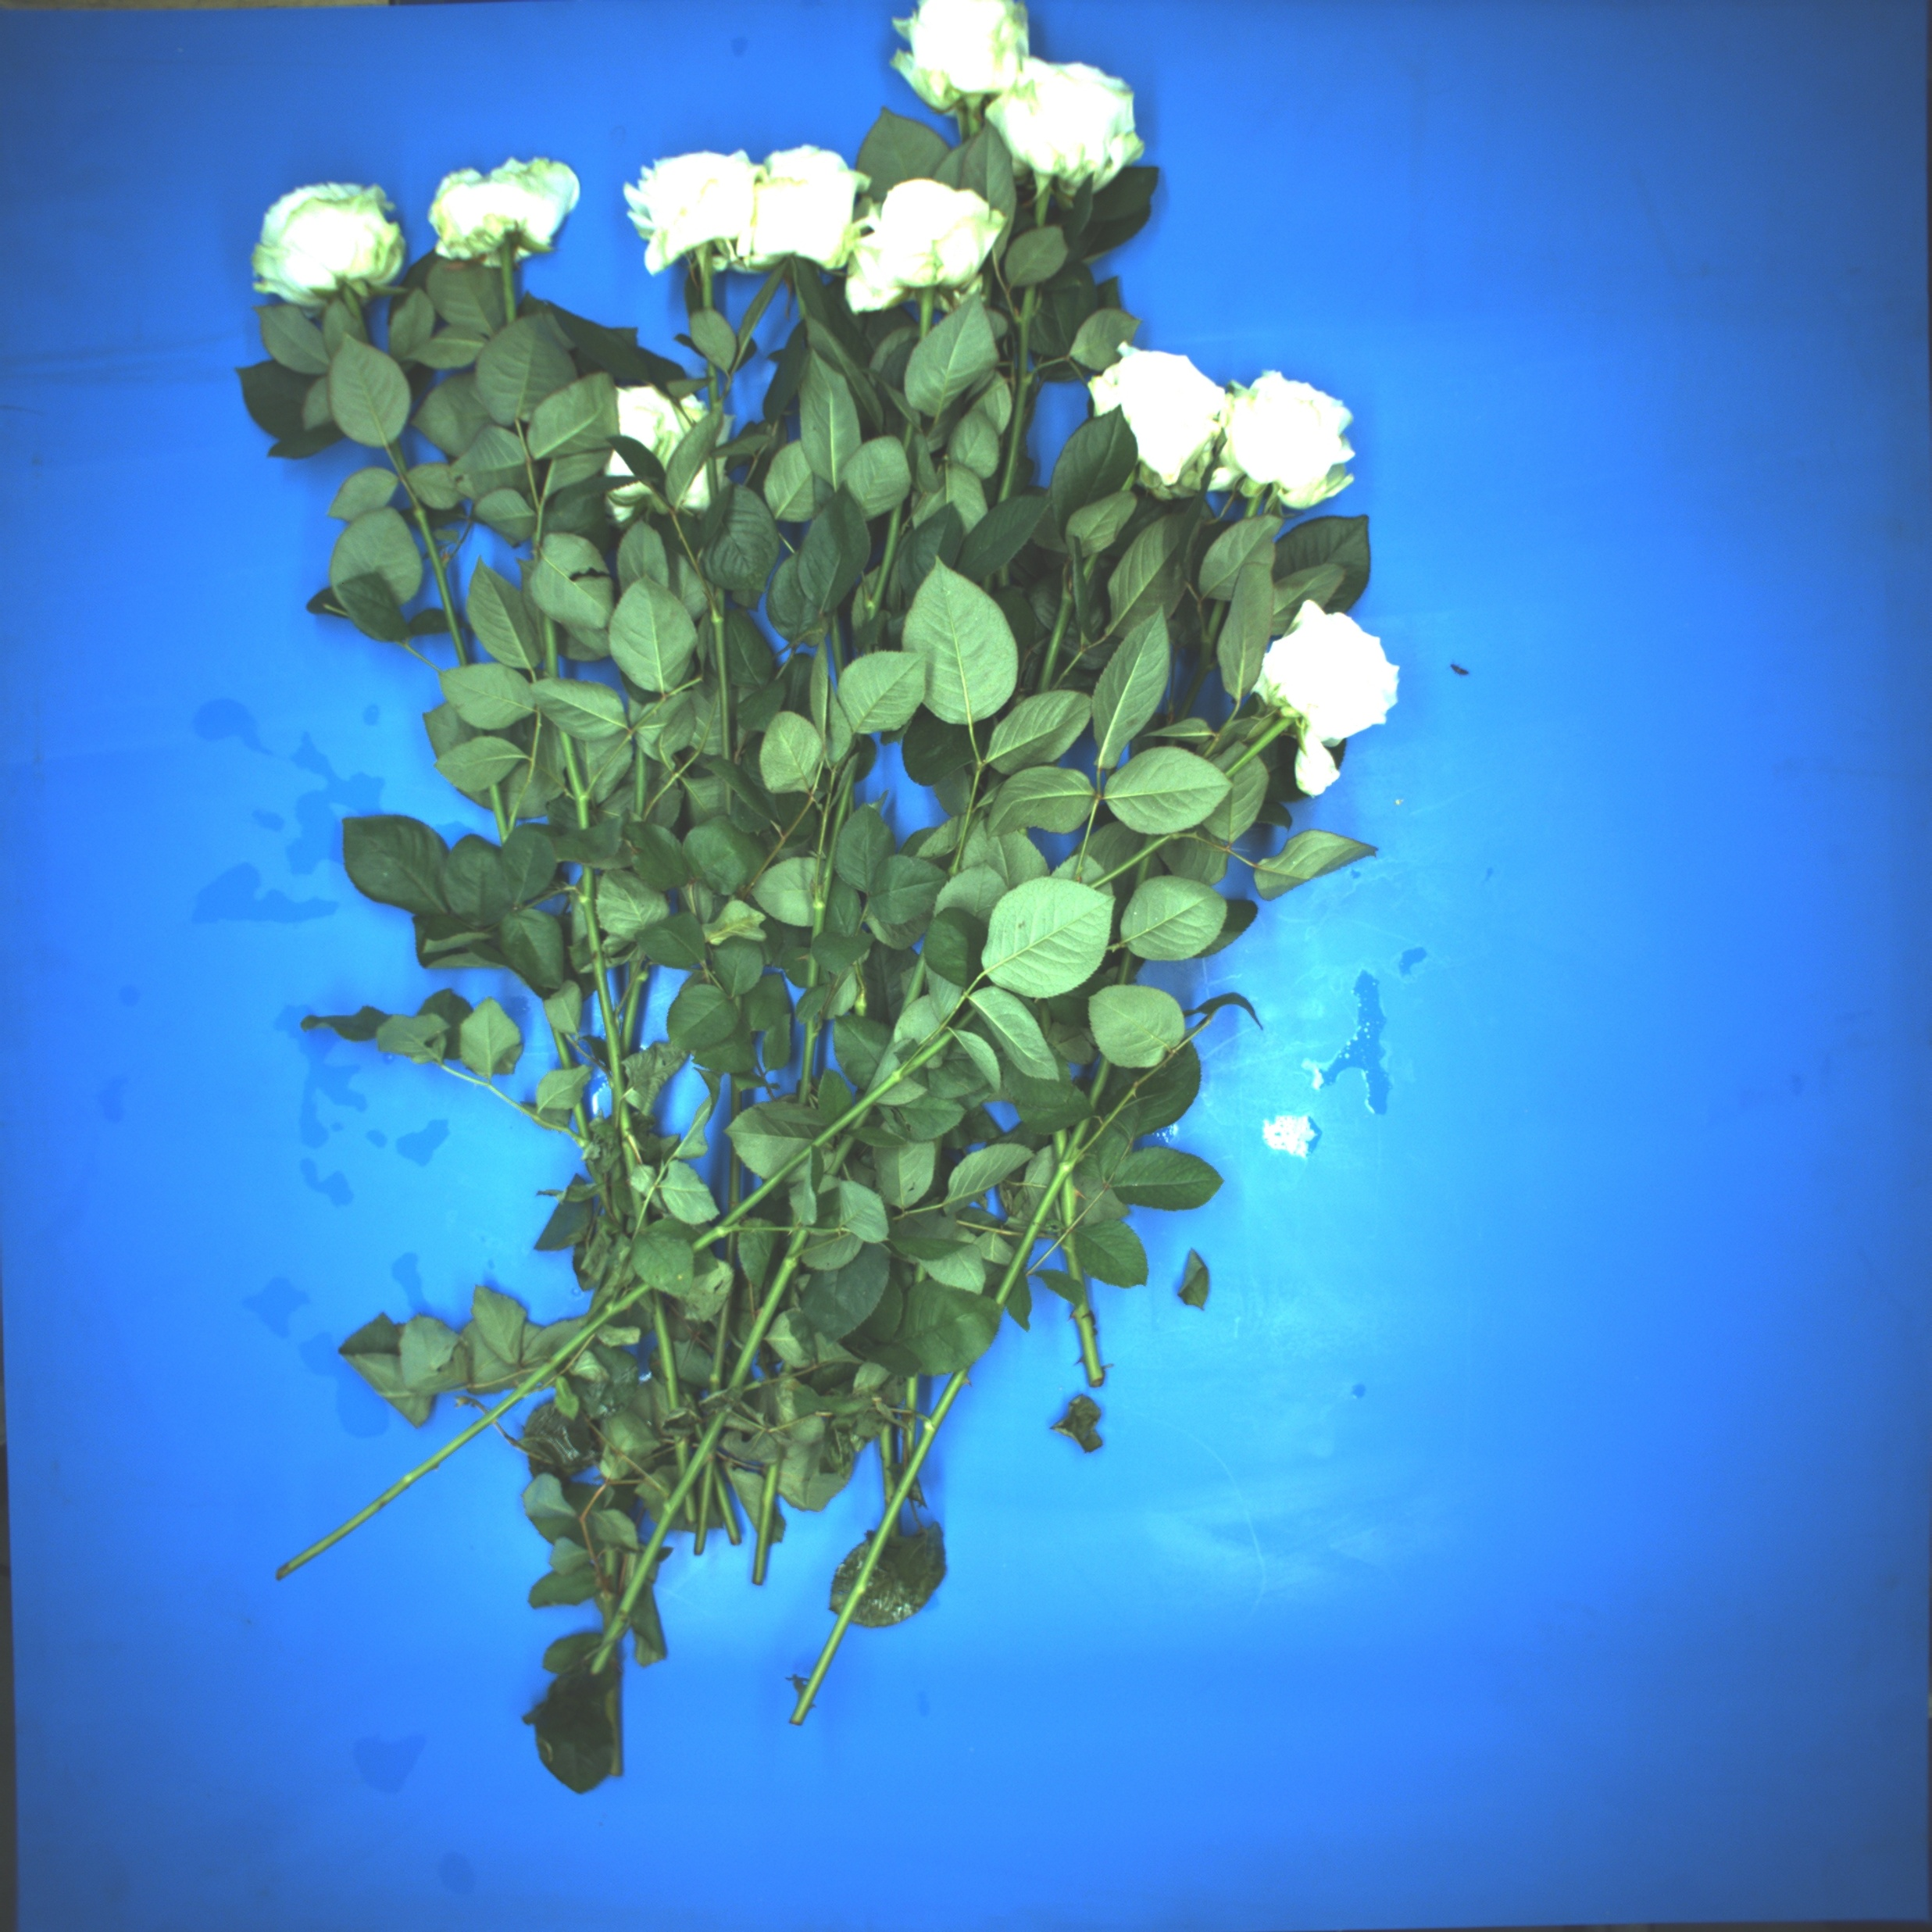
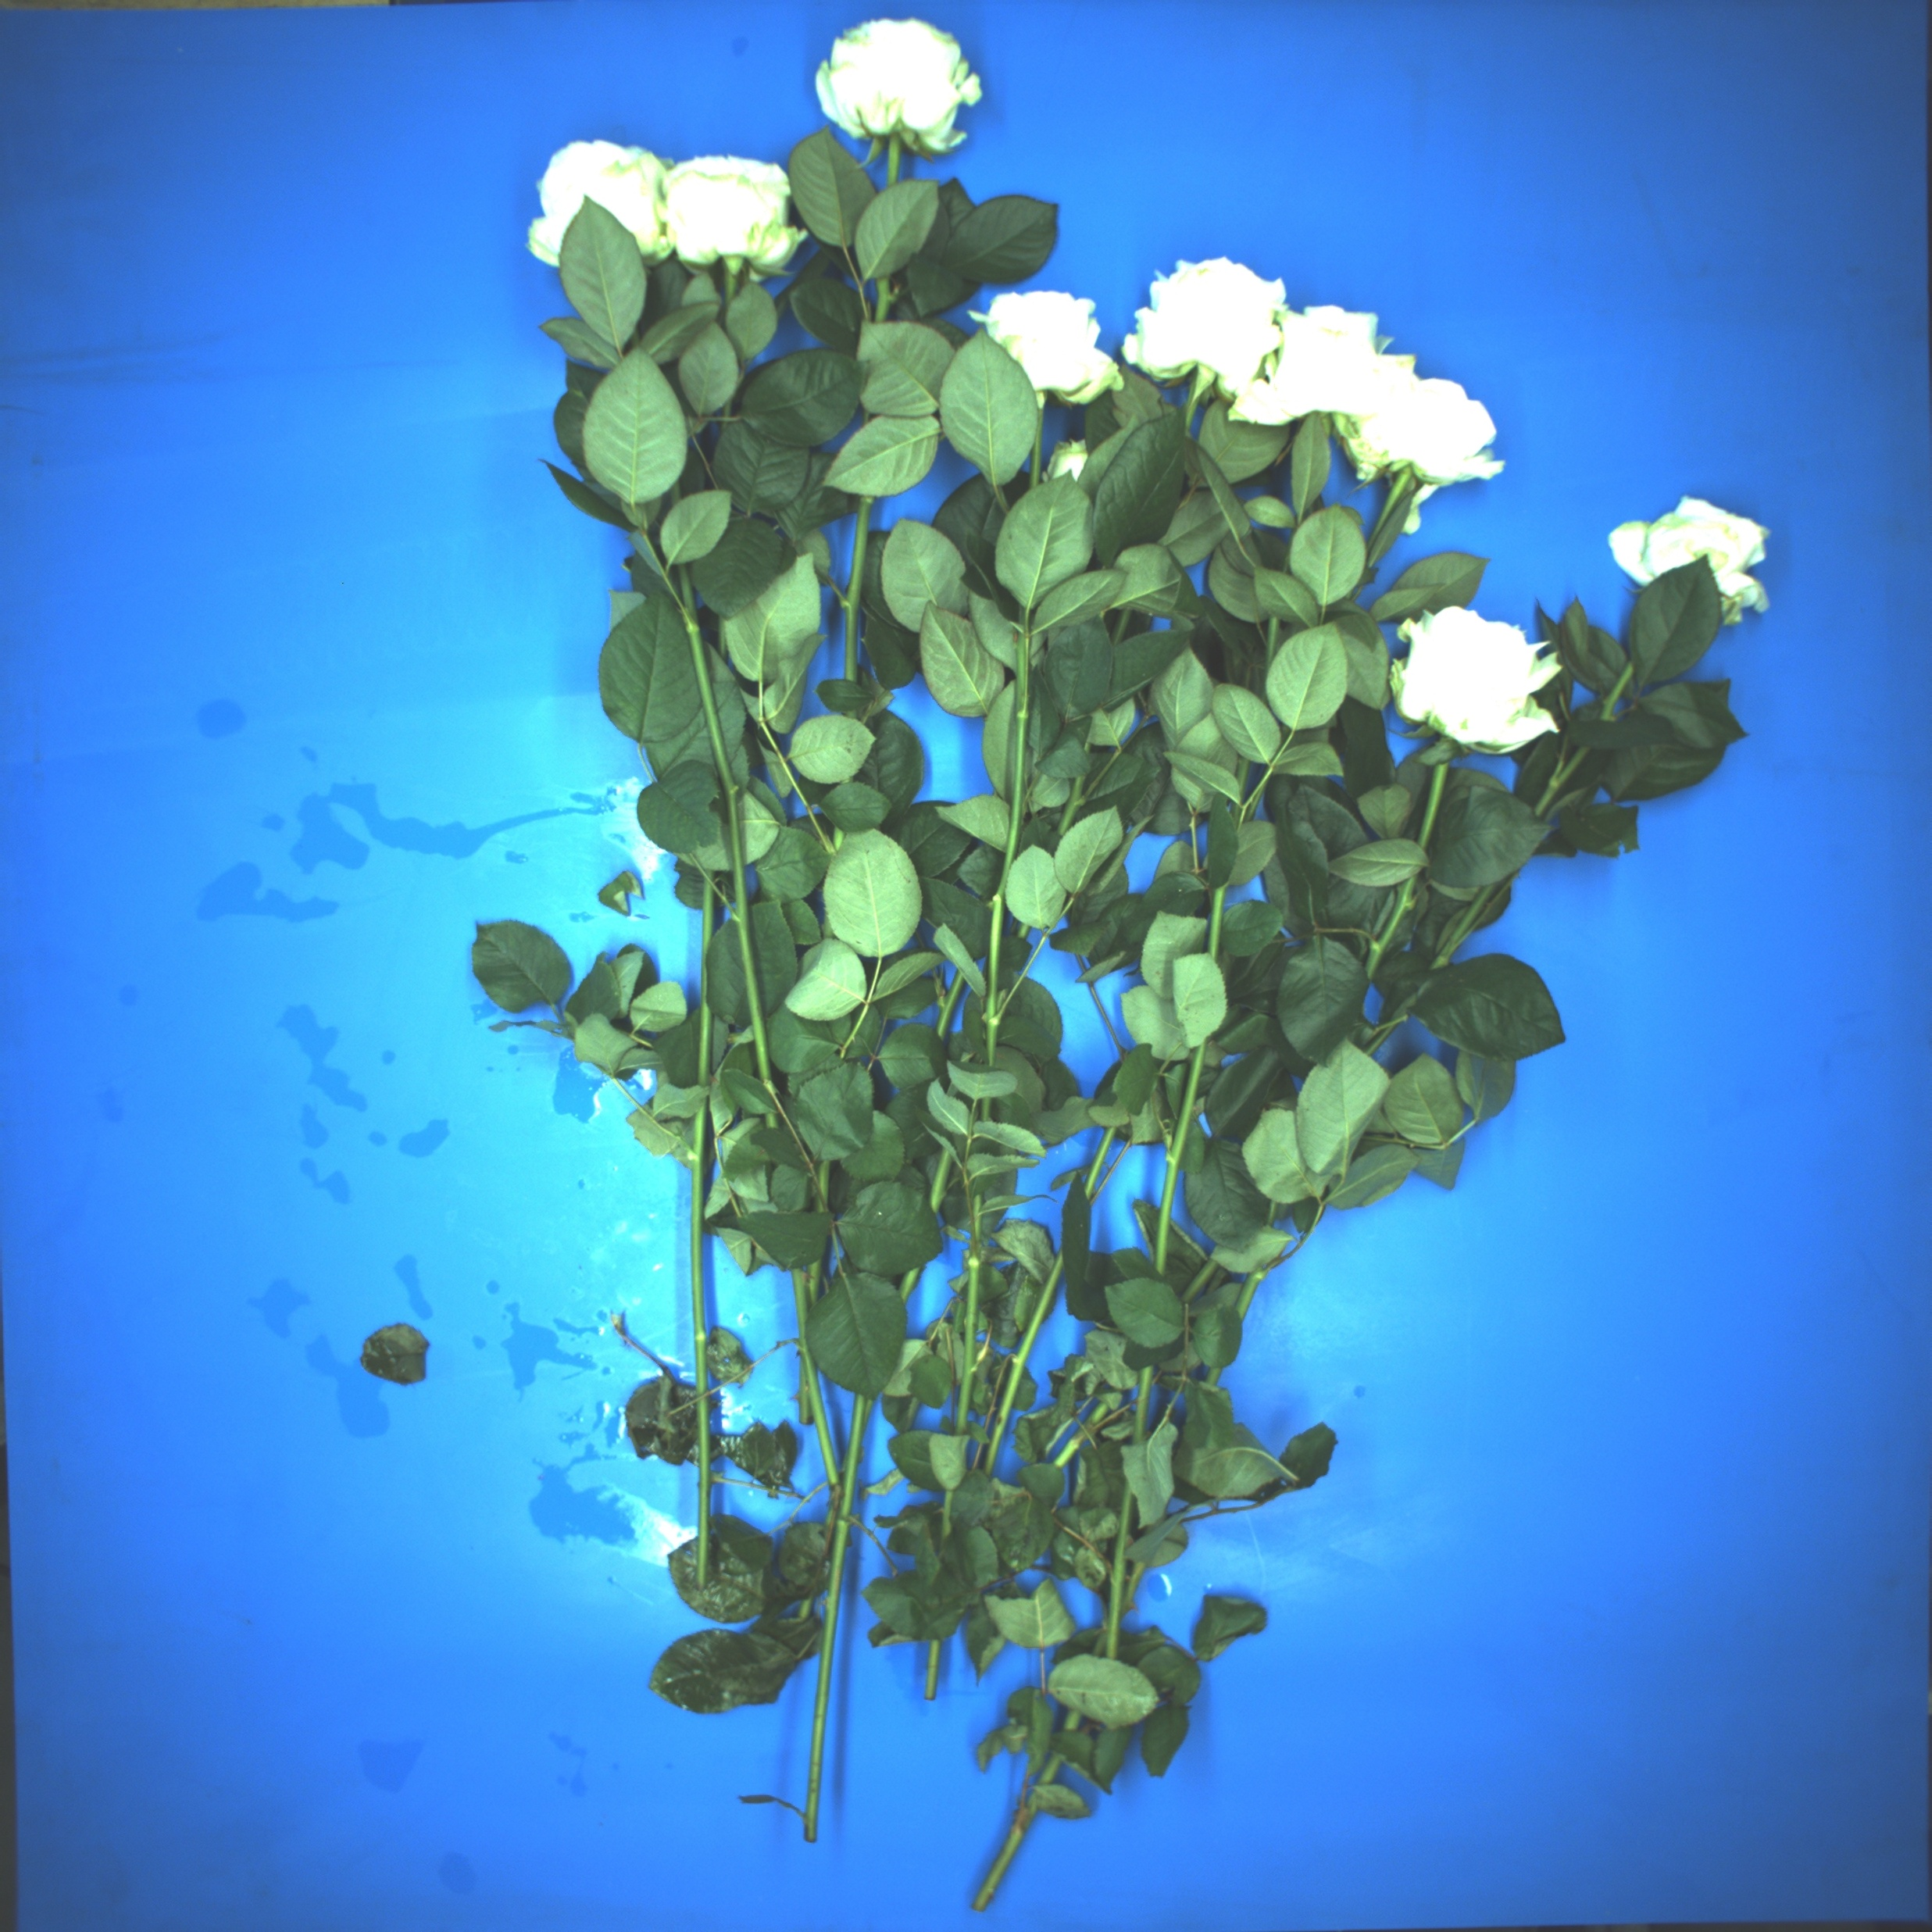
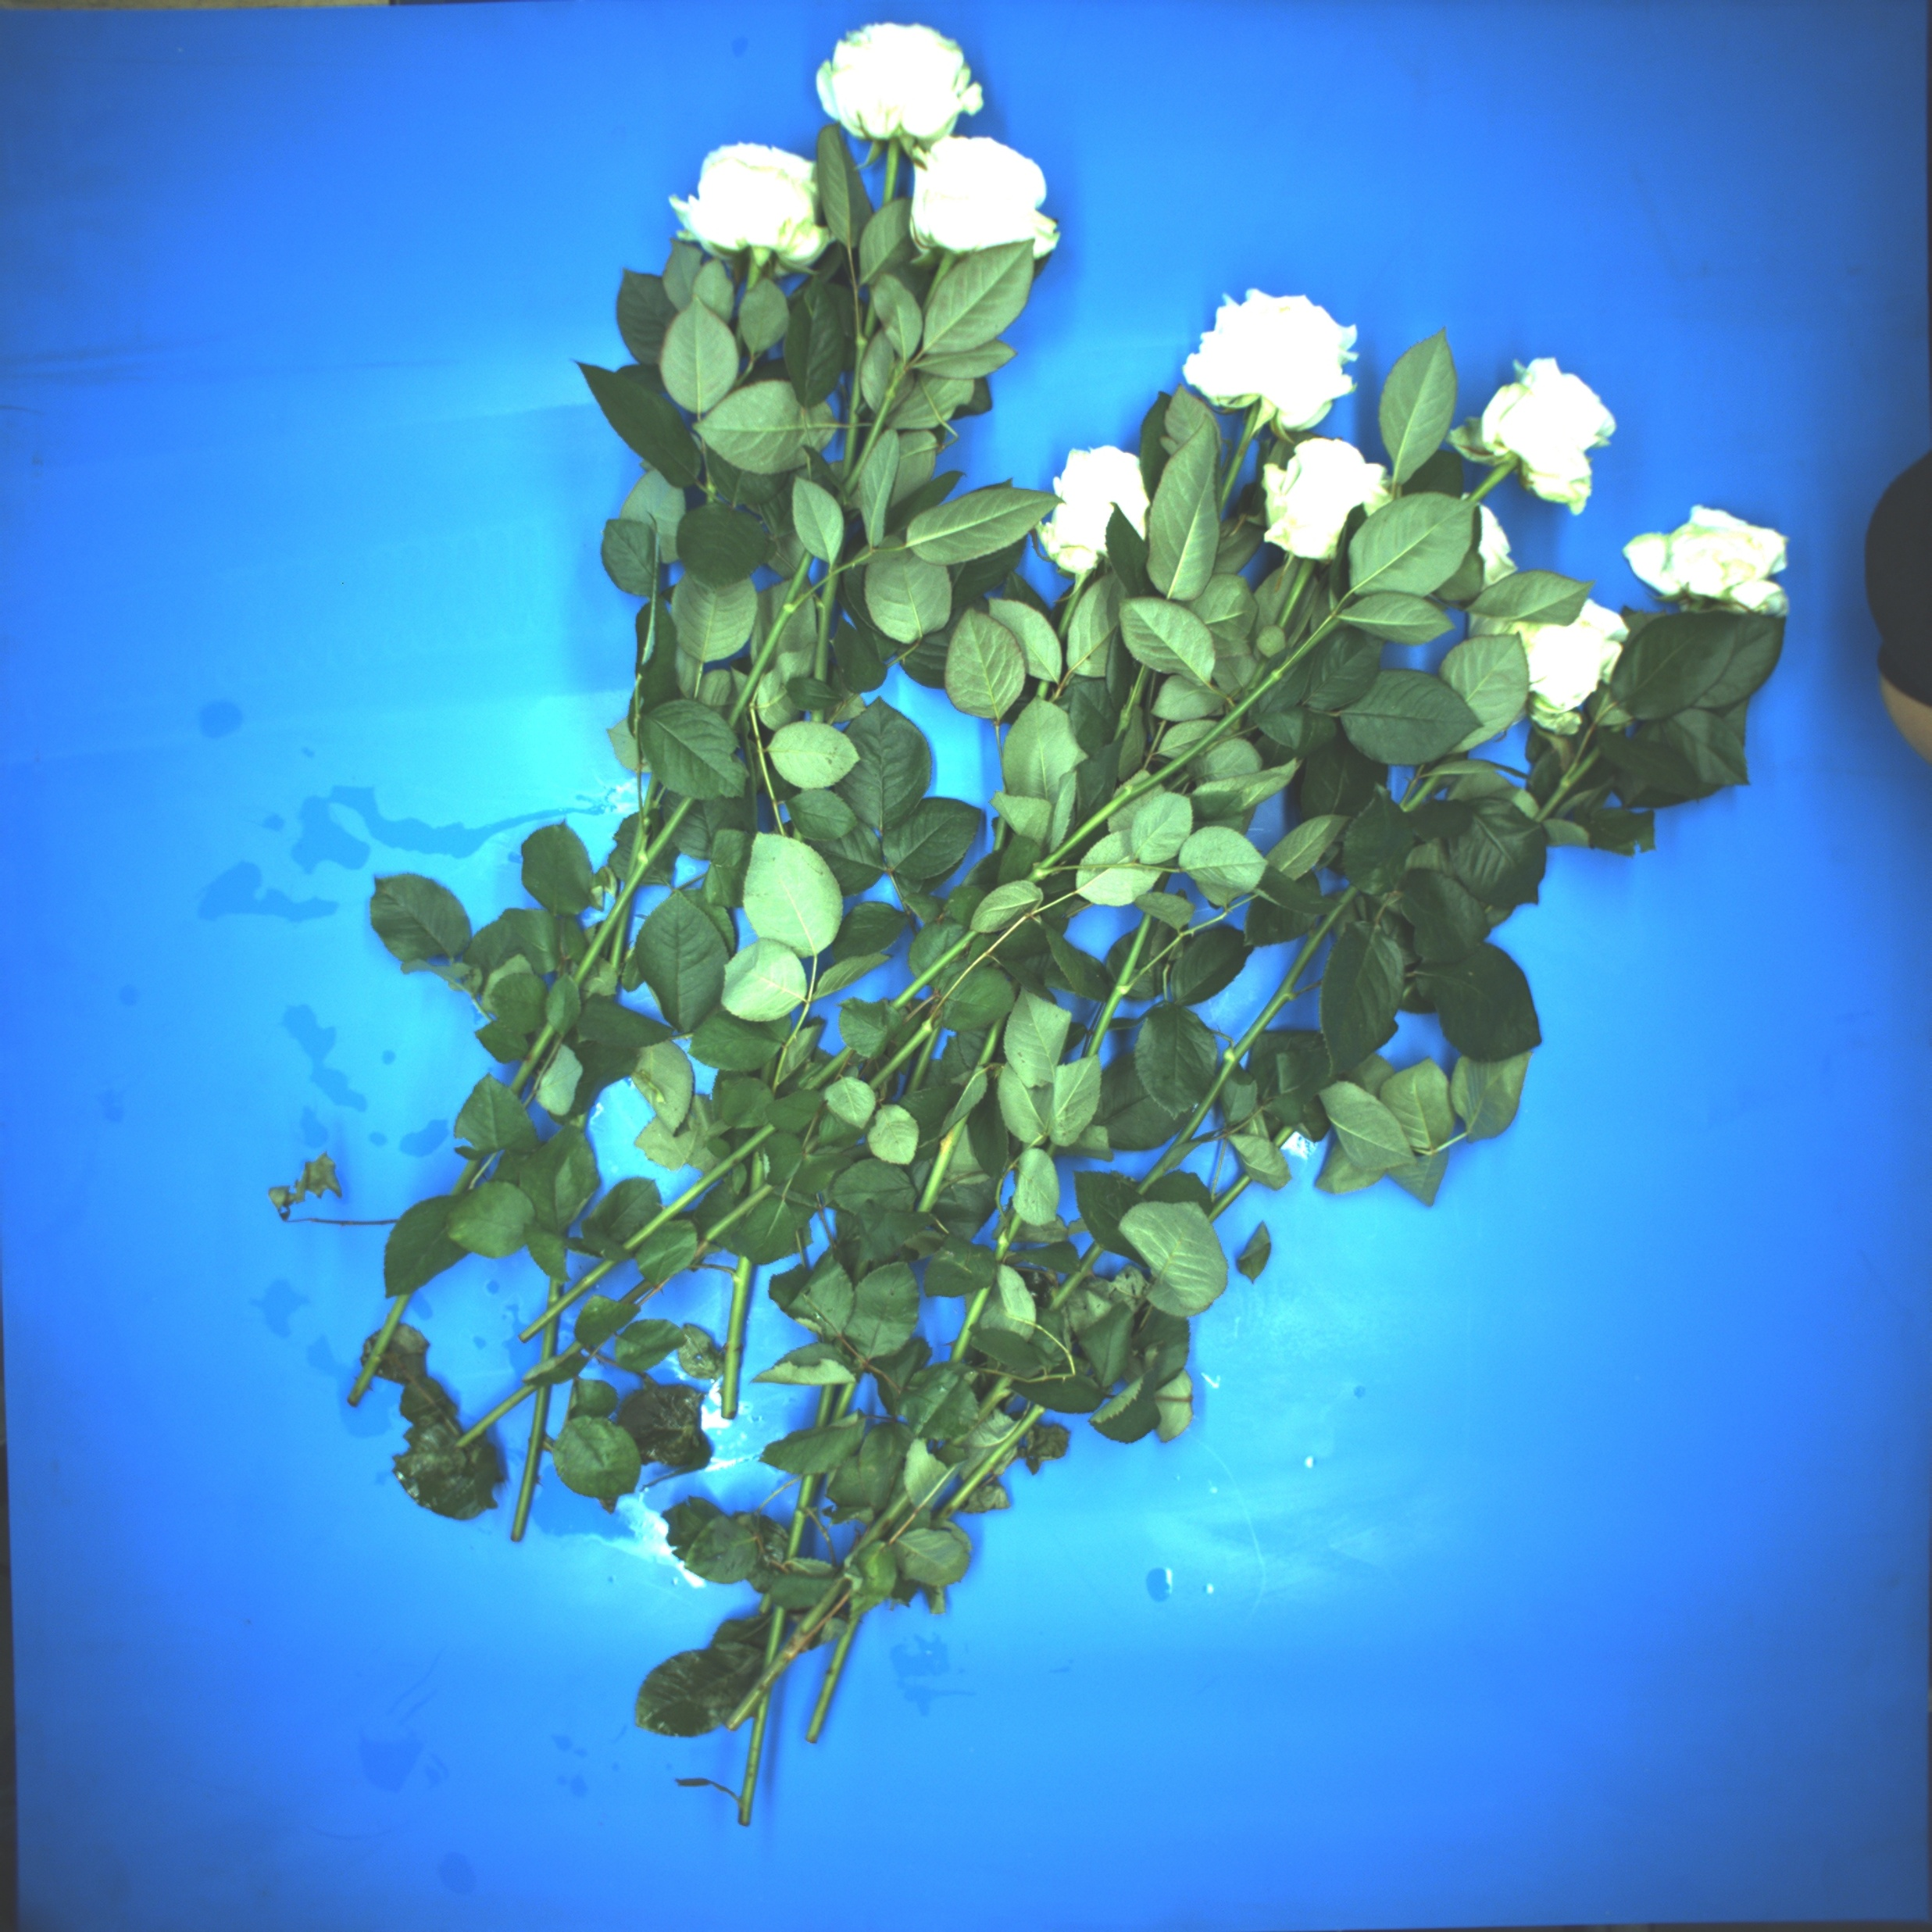
Week 3 Experiment 1 and Reflection
Hua Jiang

Slide 2
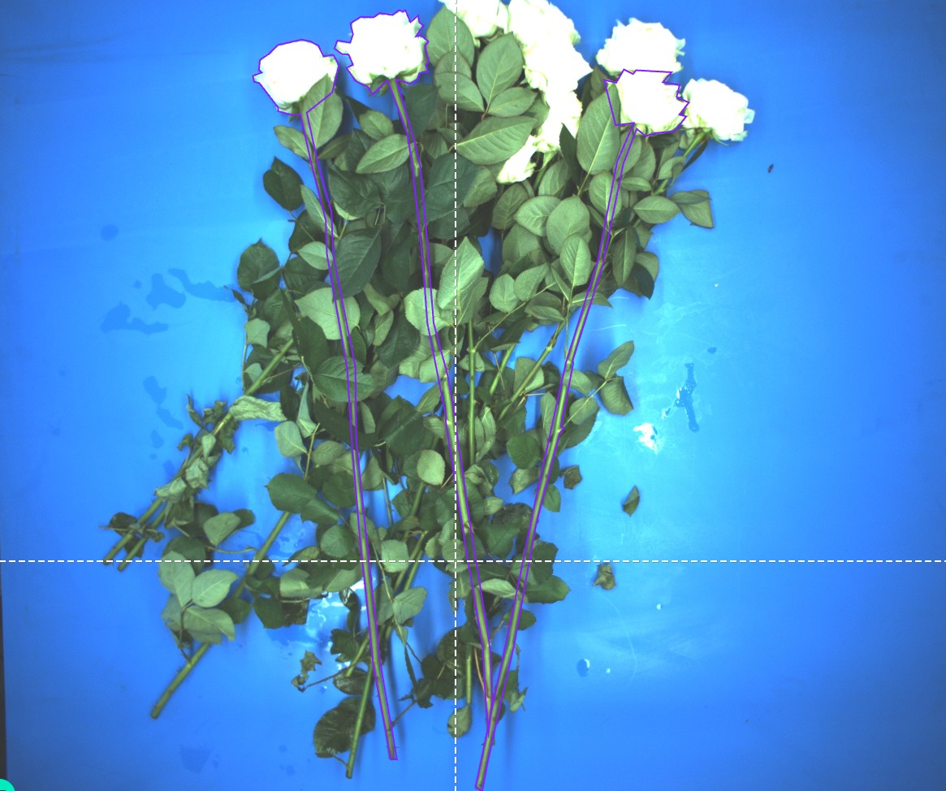
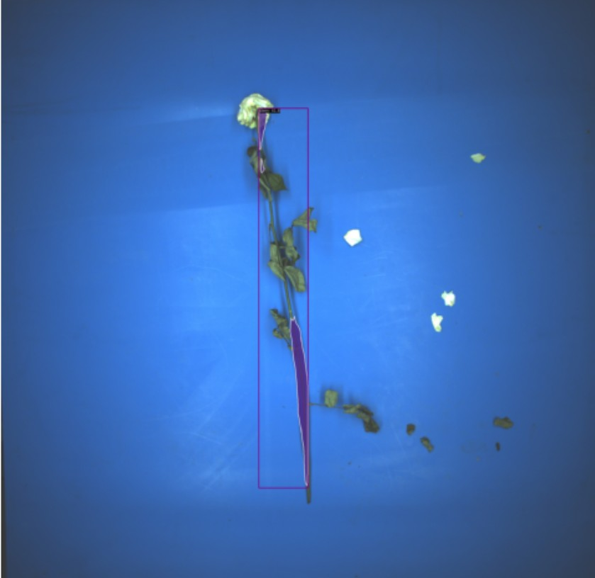
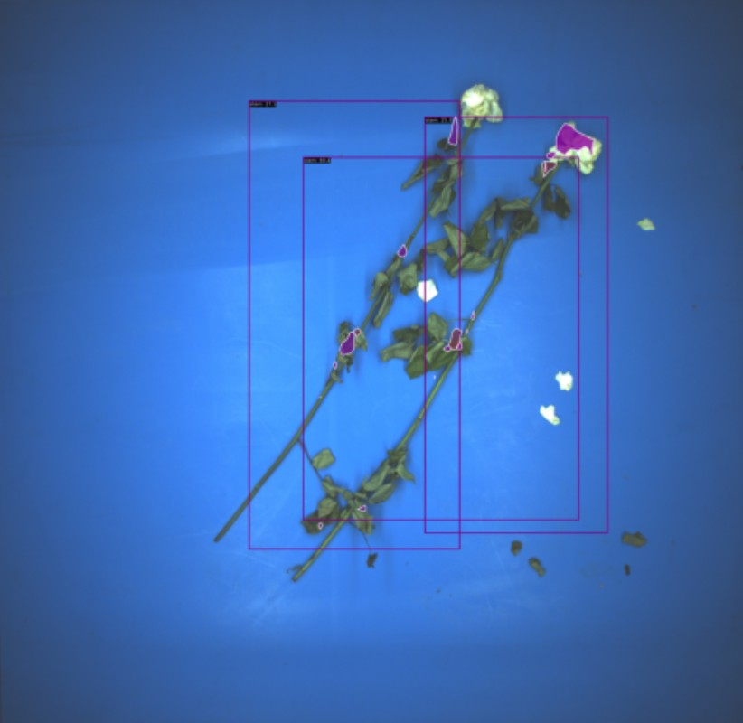
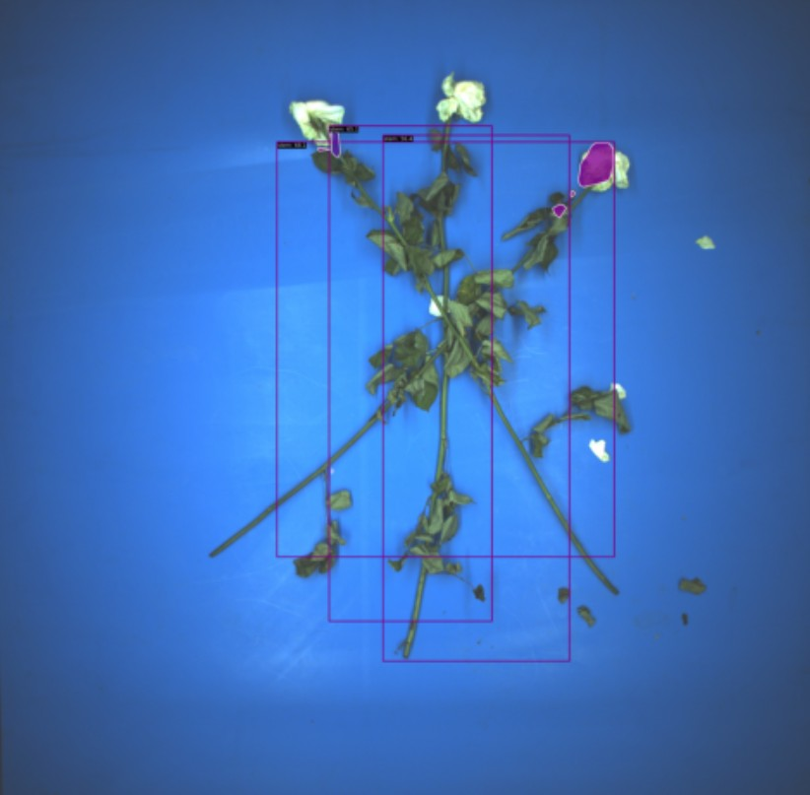
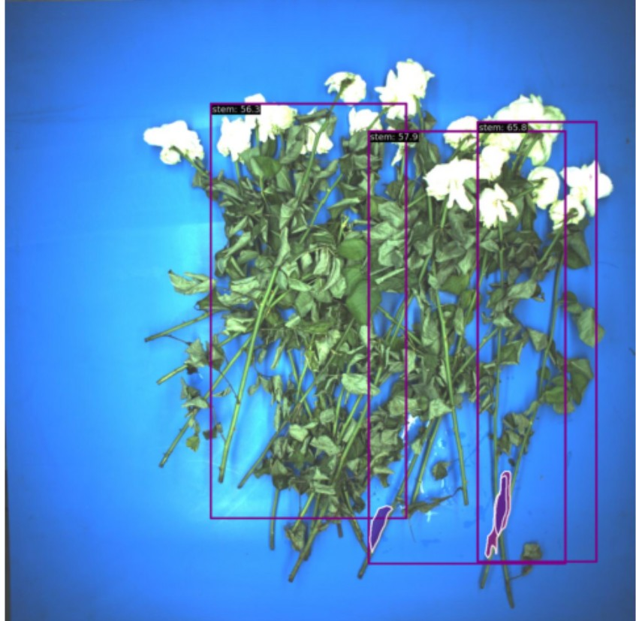
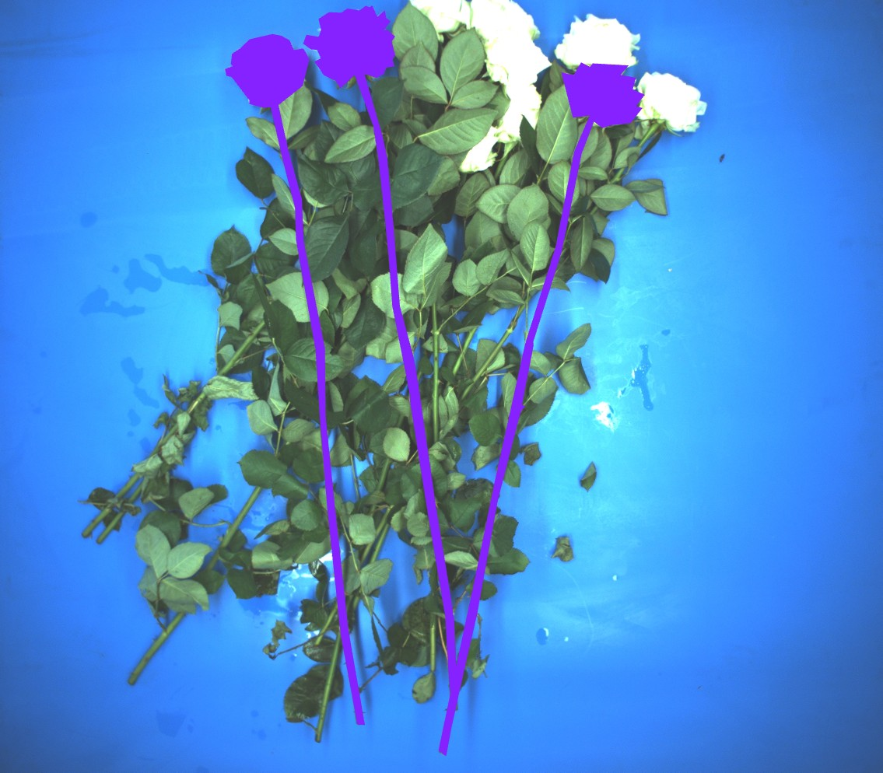
Input: 50 images annotated with masks and bounding boxes, 1280x1280.
40 training images, 10 validation images
Result:
Bad regression of bounding boxes.
Even worse classification and masks

Slide 3

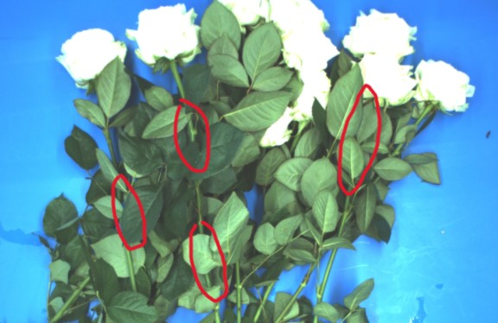
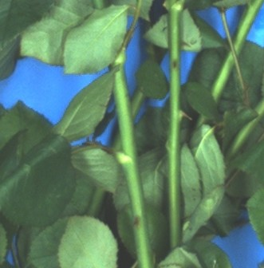
Conclusion: End to end model is unable to learn the feature of the stems on the top!
CNN can separate things of different classes apart. But if we annotate mixed things into one class, it confuses the model. (therefore no fixed feature in one class)
CNN can tell things apart even with occlusion, but not which one is on the top. CNN looks into pixel values that follow a specific rules, so it can tell flowers, leaves, and stem apart, as they have different colors/textures /contours. But the 2D image rarely includes depth information, because pixel values have little to do with layer hierarchy. Only human eyes can tell it by little changes of brightness, shadow and specific overlapping mode. Thus, for the model, flowers at top and bottom are generally the same.

Slide 4
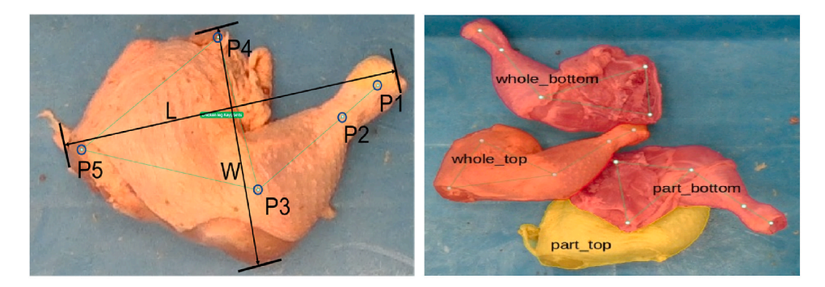
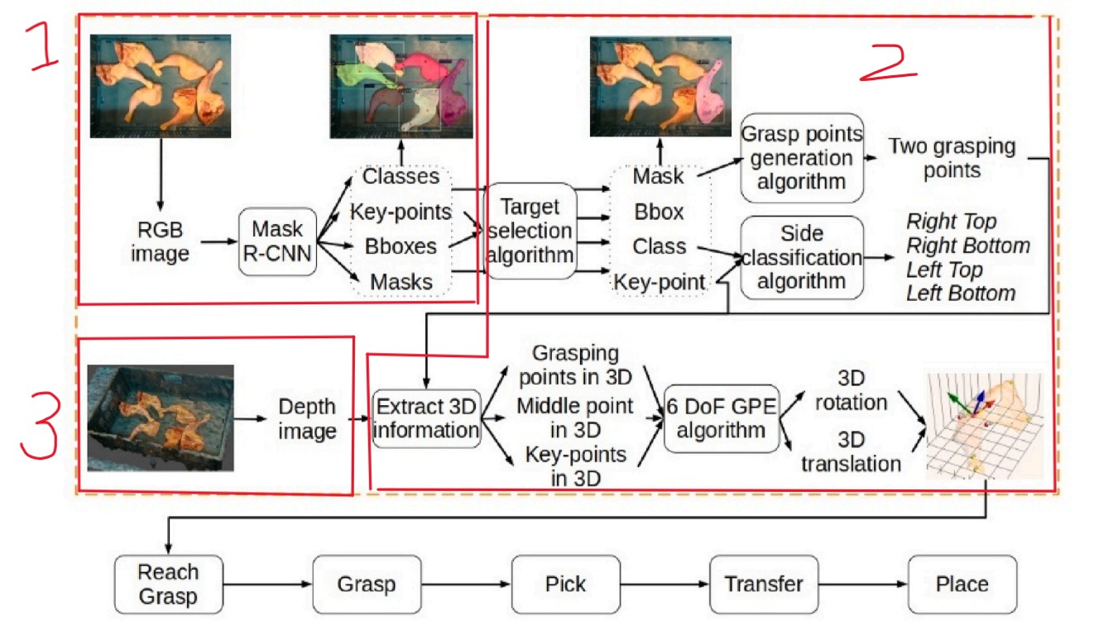
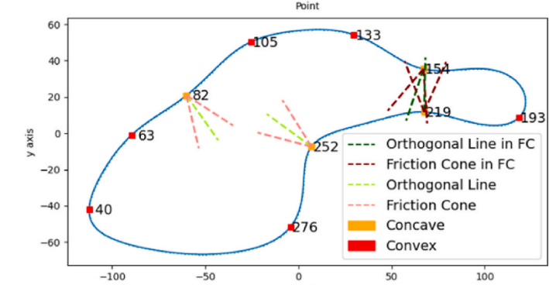
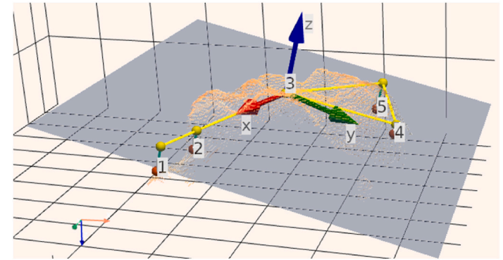
Real-time six degrees of freedom grasping of deformable poultry legs in cluttered bins using deep learning and geometric feature extraction
Mask-RCNN + State of Art method!

Slide 5
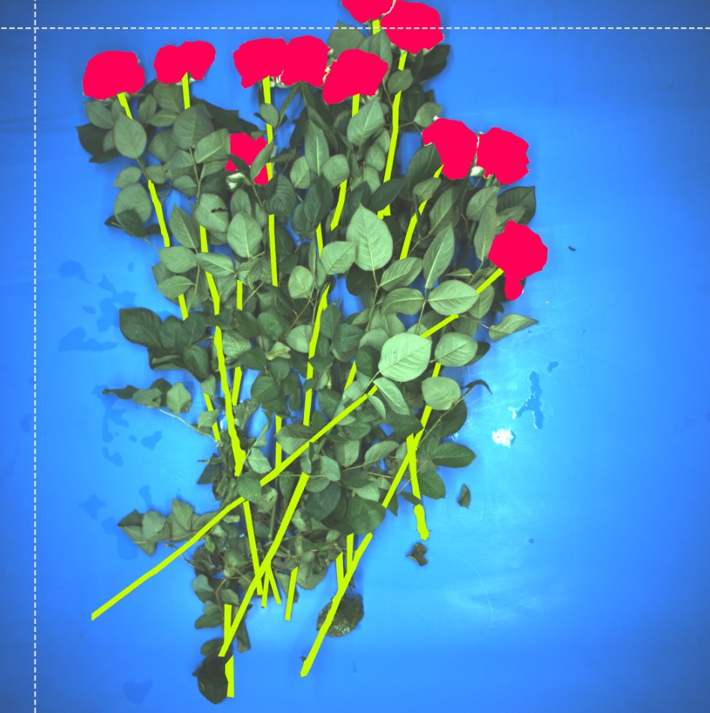
We do need State of Art method!
Step 1:
(1) Annotate all the flowers as class “flower”.
(2) Annotate all the stem fragment as class “stem”.

Slide 6
We do need State of Art method!
Step 2:
Flower as anchor, we propose the stem line for each (stem line 1-k)
For each stem segmentation, we need to find which stem line it belongs to. By calculating v = (l_p)/d, the proposed stem line with largest v occupies this stem line
Projected length l_p
There is no average distance d as 0. We set minimum to be 0.001
d

Slide 7
We do need State of Art method!
y
Step 3:
After assigning stem fragments to all stem lines. we use 2d-PCA to adjust the stem line
Adjusted
Proposed
x

Slide 8
We do need State of Art method!
Step 4:
The adjusted stem line without other stem fragments cross on it is considered at the top. If there isn’t, choose the one with least occlusion.
To keep the balance, the pick point is on the top stem fragment of this stem line.
The pick point must be there!

